Slide 1
Pairwise Testing Services
Group 4 Report 5
张坚 王冠 吕冰洁 顾永超 刘伟

Slide 2
Jenny An Open Source Combinatorial Testing Tool

Slide 3
Overview
Aim
Generating regression test cases
Written in C
Platform independent
Non-deterministic

Slide 4
Terminology
Dimension
The type of a variable
The type of comparison (>, <, ==)
Feature
Possible values in a dimension
For instance:
typedef enum {FALSE, TRUE} BOOL;

Slide 5
Reason behind
Exhaustive testing is overkill
12 dimensions of 2 features each: 2^12 = 4096
Three-feature combination is enough

Slide 6
Usage
Command line arguments:
2..52: features in one dimension
n: n-tuple of features
w: without given combination of features
s: seed the random number generator
o: read old test files
h: help

Slide 7
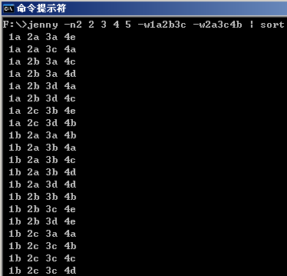
Example

Slide 8
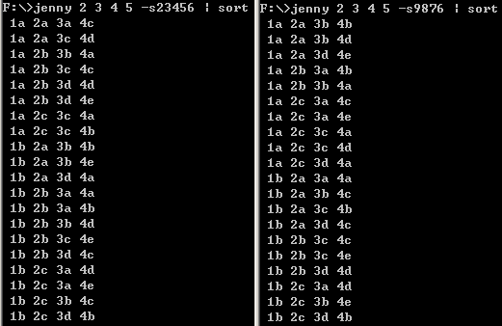
Comparison

Slide 9
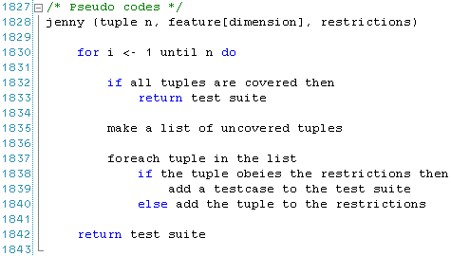
Algorithm

Slide 10
Data Structure
struct feature
struct tu_arr, tu_iter /* tuple array & iterator */
struct test /* test case, a combination of features */
struct without, wchain /* restrictions */
struct state

Slide 11
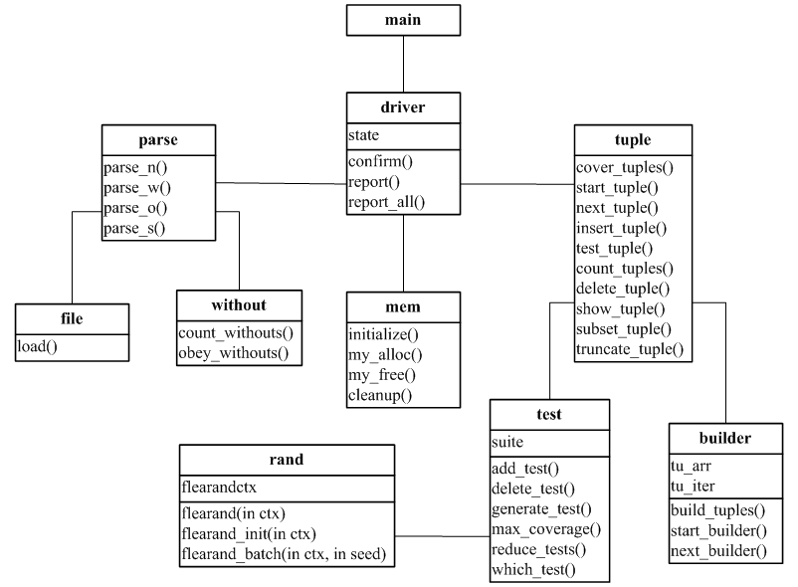
Modules

Slide 12
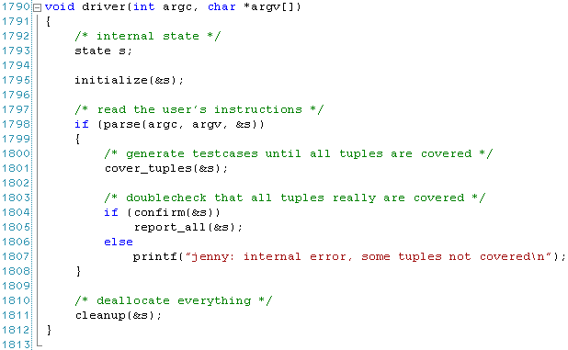
General Routine

Slide 13
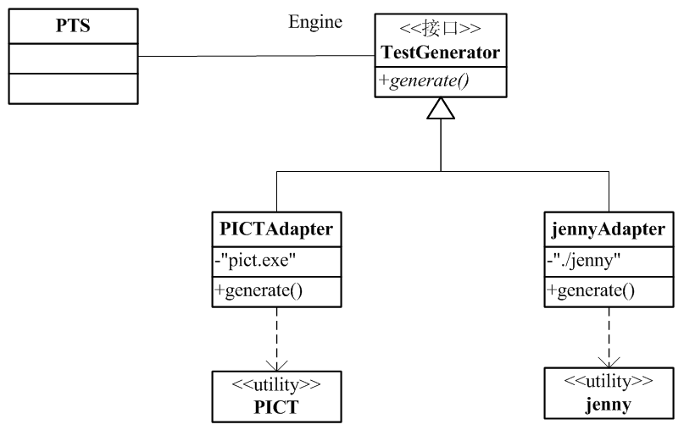
Integration
Adapter

Slide 14
Fin

